Slide 1
RP-0 Official Parts Tech Tree
Here is a breakdown of the different parts of the spreadsheet that is currently used to generate the tech tree portions of the parts in RP-0.
This has been put together to handle everything you need it to, but it can be improved with some simple JavaScript that will basically allow “macros” on the sheets to generate the stuff you need.
I will go through each sheet one by one to explain the function.
What is important to know is that the PARTS sheet is what drives the entire spreadsheet. The rest of the sheets should not need to be modified, they are only needed to generate the configs.

Slide 2
Parts
This file controls the rest of the spreadsheet. It has relevant information on every part that is in the RO database, including many parts that are not fully configured for RO or RP-0, but are part of mods that are already configured. I will first go through each column to explain the function of it.
Mandatory data will be highlighted in RED
Column A = Name
This is the name of the part in KSP terms, this is what is referenced in every other sheet to set the values needed
Column B = Title
Title (name of the part) that is seen by the player in the game
Column C = Cost
Cost of the part when putting it on a rocket
Column D = EntryCost
Entry cost when unlocking the part in the tech tree. The values here are not exactly representative of what it will actually cost, I’ll go into more detail when I discuss the ECM sheet.
Column E = Description
The in-game description of the part
Column F = MOD
The mod that the part comes from. It is important to format this correctly as it is added to the description for the player to see.

Slide 3
Parts
Column G = RO
Does this part have a config created for RO (Yes / No / Rework)
This affects the Description in the game and where it shows up in the VAB
Column H = RP-0
Is this part properly placed in the Tech Tree and does it have an accurate cost (No / No Cost / Yes)
This affects the Description in the game and where it shows up in the VAB
Column I = CATEGORY
Category of the tech tree where this part is located
This affects Column K (Technology)
Only possible values:
AVIONICS, COMMAND, COMMS, EDL, ELECTRONICS, FLIGHT, HYDROLOX, ION, LS, MATERIALS, NTR, NUCLEAR, ORBITAL, POWER, RCS, SCIENCE, SOLID, SPACEPLANES, STAGED, STATIONS
Column J = INFO
Does not affect anything in game. This is used by the person configuring the part to determine costs, tech tree location and other information.
Column K = TECHNOLOGY
Locked Formula
This uses the value in Column I (CATEGORY) and Column L (YEAR) to determine what technology unlocks the part

Slide 4
Parts
Column L (YEAR)
Year the part should be unlocked
Works with Column I (CATEGORY) to set the Technology of the part
Column M (ERA)
Locked Formula
Uses the value of Column L (YEAR) to determine which of the RP-0 eras it falls in on the tech tree
Not an important column, it is used to make sure the part unlocks when you want it to
Column N (ORPHAN)
Important column that tells other formulas whether to consider the part
Possible values are:
(blank) = Part should be read by all other formulas
External = Part is placed on the tech tree in an external file and is not affected by this sheet
Yes = Part is Orphaned and should not be considered by other formulas (including placement in the tech tree)
Column O (RP0conf)
Important column that sets the description and categories of parts in the VAB
Possible values are:
(blank) = Part is not configured for RP-0 and should not be placed in the tech tree
false = Part is placed correctly on the tech tree, but does not have proper costs
true = Part is placed correctly and has accurate costs

Slide 5
Parts
Column P (SPACECRAFT)
Used to organize parts by the different spacecraft.
Does not do anything to the config, but is used to group parts of the same craft together to make sure unlocked at proper times
Column Q (ENGINE CONFIG)
Engine Config that the part falls under
This also includes parts from the Engine_Config mod. These are the actual engine config parts that generate the upgrades and proper unlock technologies for the engine upgrades
Column R (UPGRADE)
Specifies whether an Engine_Config is an Upgrade of a previous engine.
Possible Values: YES, (blank)
This creates the tech tree upgrade part information
Column S (SAME)
Column is no longer used
Do not delete as it may affect saved formulas
Column T (PLACEMENT NOTES)
This is used to tell others why you chose to place a part in a specific tech node
Column U (COST NOTES)
This is used to tell others why you set the cost as you did

Slide 6
Parts
Column V (DATE ADDED)
What date did you add the part to the sheet?
Column W (ECM’s)
This sets what modifiers are used by the Entry Cost Modifiers
I will go into more detail on this with the ECM Sheet
Column X (IDENTICAL)
These are the parts that are identical to each other and should all unlock when one is unlocked
Use the “Name” value from Column A
Values are separated by commas
Used to create the IDENTS sheet Configs
Columns Y-AP (Tag Modules added to the Part)
These are the different tags that modify the costs, tooling and maintenance modules.
These are used to create the TAGS sheet that is then used by the TREE to create the Tech Tree values
Only acceptable values are “X” or (blank)
Modules:
Avionics, DecA, DecB, EngLqdPF, EngLqdTurb, EngSolid, Habit, Human, Instrum, Nuke, Toxic, Decoup, Hydro, Balloon, SM, NonReentry, Unpress

Slide 7
Parts
Columns AQ to AS
Only used to help with costing and tooling, has no impact on anything else

Slide 8
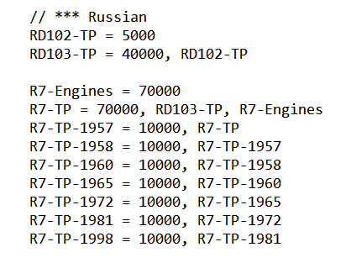
ECM Sheet
This sheet generates the config text for the following files:
ECM-Engines.cfg
ECM-Parts.cfg
TREE-Engines.cfg
ECM stands for Entry Cost Modifiers and this controls what the Entry Costs (unlock costs) will be for each part. The unique thing about this system is that it subtracts costs if parts in the same family have been unlocked. For example, for the R7 Engine family, each engine costs 70,000 + 10,000 for each additional engine. So, if you try to unlock the first engine, it will cost 80,000. If you then unlock the 2nd engine, it will cost 10,000. However, if you skip the first engine and just try to unlock the 2nd engine, it will cost you 90,000.
The actual Entry Cost Modifiers (what affects the pricing) are located in the EntryCostModifiers.cfg file. This is a section from that file:

Slide 9
ECM Sheet
Column A
Locked Formula
ECM’s column. These are the ECM’s on all parts.
The formula finds the part NAME and the ECM’s from the Parts sheet. If it finds a part that is not orphaned and should be looked at, it creates an entry that is:
Name = ECM’s
If it does not find a part that should be configured, it returns a “zzz”.
The sheet is configured this way so that it is easy to filter out the entries that are relevant to the config.
Column B
Locked Formula
Engine Config ECM’s column. These are all of the ECM’s that exist for the engine configs.
The formula finds the part NAME and the ECM’s from the Parts sheet. If it finds a part that is not orphaned and is part of the MOD Engine_Configs, it creates an entry that is:
Name = ECM’s
If it does not find a part that should be configured, it returns a “zzz”.
The sheet is configured this way so that it is easy to filter out the entries that are relevant to the config.

Slide 10
ECM Sheet
Column C (Is_EC)
Locked Formula
Returns of TRUE or FALSE depending on the values from the Parts sheet
It only returns TRUE if the MOD is Engine_Config
Column D
Locked Formula
This column generates the configs for the TREE-Engines.cfg file
Returns data from the Parts sheet that will put the parts into the proper place in the tech tree with the proper costs, descriptions and if necessary, upgrade icons
Column F
Locked Formula
Generates the end of the TREE-Engines.cfg file
These are the upgrades for the engines that allow them to be shown in the Tech Tree instead of being a surprise to the player

Slide 11
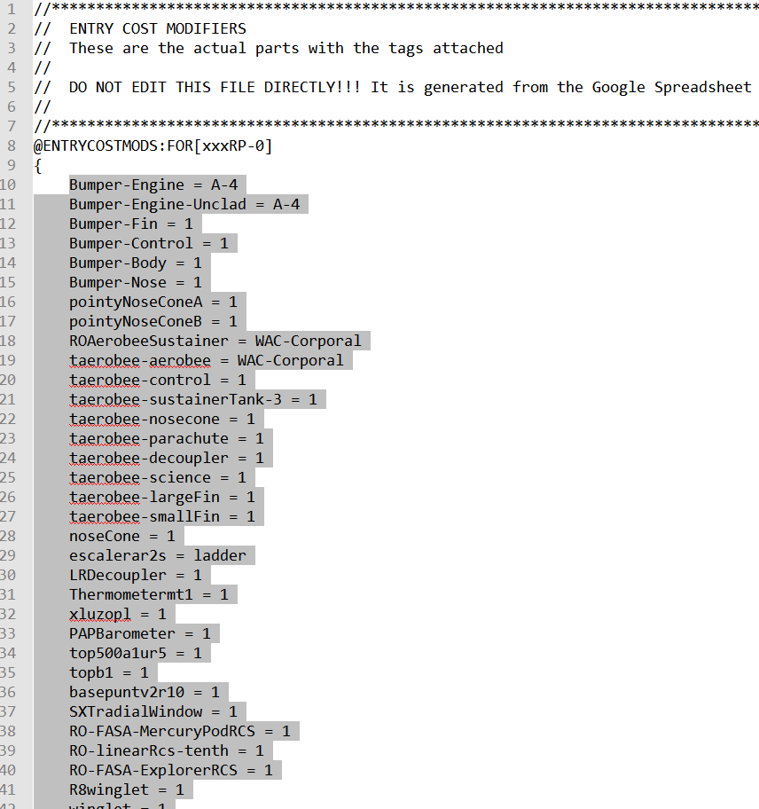
GENERATING ECM-Parts.cfg
Open ECM-Parts.cfg in your favorite Text Editor
Delete all rows from after the opening bracket { to before the closing bracket }

Slide 12


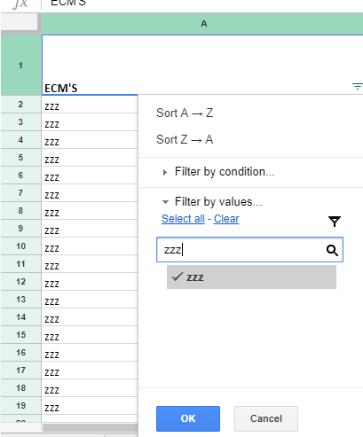
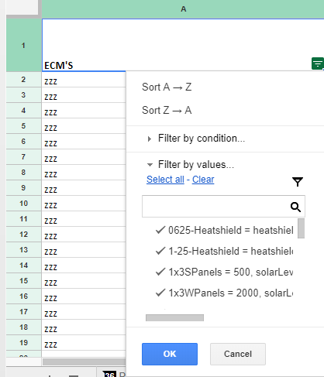
GENERATING ECM-Parts.cfg
Go to ECM sheet on the Google Spreadsheet
Be sure that there is no filter set
Select Column A (click directly on the column header A) and then click on the Filter Button
Click the 3 line icon in the bottom right corner of cell A1
Search for zzz in the box and unclick the checkmark next to it and click OK

Slide 13
GENERATING ECM-Parts.cfg
Column A now only has the relevant information needed to transfer to the config file
Put your cursor in the first entry below the header -> Hold Down CTRL-SHIFT and hit the down arrow
This will select all of the values in Column A
Copy the data
Paste it into the ECM-Parts.cfg file
Make sure you are pasting it between the { and }
Save the ECM-Parts.cfg

Slide 14
Generating ECM-Engines.cfg
Open ECM-Engines.cfg in your favorite Tech Editor
Delete all rows from after the opening bracket { to before the closing bracket }
Go to ECM sheet on the Google Spreadsheet
Be sure that there is no filter set
Select Column B (click directly on the column header B) and then click on the Filter Button
Click the 3 line icon in the bottom right corner of cell B1
Search for zzz in the box and unclick the checkmark next to it and click OK
Column B now only has the relevant information needed to transfer to the config file
Put your cursor in the first entry below the header -> Hold Down CTRL-SHIFT and hit the down arrow
This will select all of the values in Column B
Copy the data
Paste it into the ECM-Engines.cfg file
Make sure you are pasting it between the { and }
Save the ECM-Engines.cfg

Slide 15
Generating TREE-Engines.cfg
Open TREE-Engines.cfg in your favorite Tech Editor
Delete ALL data in the file below the header
Go to ECM sheet on the Google Spreadsheet
Be sure that there is no filter set
Select Column D (click directly on the column header D) and then click on the Filter Button
Click the 3 line icon in the bottom right corner of cell D1
Search for zzz in the box and unclick the checkmark next to it and click OK
Column D now only has the relevant information needed to transfer to the config file
Put your cursor in the first row D1 -> Hold Down CTRL-SHIFT and hit the down arrow
You need to make sure you have Row 1 selected as it is the first part of the file to generate
This will select all of the values in Column D
Copy the data
Paste it into the TREE-Engines.cfg file

Slide 16
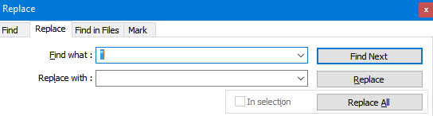
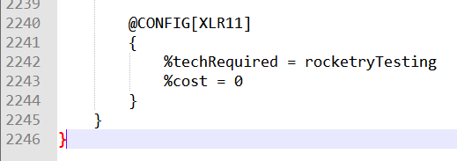
Generating TREE-Engines.cfg
Search and Replace all “ with nothing
Put cursor at the end of the file, on a new line add a closing bracket }, on a new line add a second closing bracket
Put cursor at the end of the file and hit Enter twice to create a blank row
Go to ECM sheet on the Google Spreadsheet
CLEAR ALL FILTERS
Select Column F (click directly on the column header F) and then click on the Filter Button

Slide 17
Generating TREE-Engines.cfg
Click the 3 line icon in the bottom right corner of cell F1
Search for zzz in the box and unclick the checkmark next to it and click OK
Column F now only has the relevant information needed to transfer to the config file
Put your cursor in the first entry below the header -> Hold Down CTRL-SHIFT and hit the down arrow
This will select all of the values in Column F
Copy the data
Paste it into the bottom of the TREE-Engines.cfg
Search and Replace all “ with nothing
Add an extra blank line at the end of the file
Save the TREE-Engines.cfg

Slide 18
TREE Sheet
This sheet generates the config text for the following files:
TREE-Parts.cfg
This is the sheet that controls all part placement in the Tech Tree. It looks up data from the Parts sheet and modifies the resulting information to create the information that is required for the tech tree.
The complicated looking formula does the following:
Gets the part name and formats it correctly with an @PART and FOR[xxxRP0]
Gets the TechRequired
Gets the Cost
Gets the entryCost
Gets the RPOconf value
Modifies the description to add the mod that the part is from
Adds the proper Module Tags to the part

Slide 19
Generating TREE-Parts.cfg
Open TREE-Parts.cfg in your favorite Tech Editor
Delete ALL data in the file below the header
Go to TREE sheet on the Google Spreadsheet
Be sure that there is no filter set
Select Column A (click directly on the column header A) and then click on the Filter Button
Click the 3 line icon in the bottom right corner of cell A1
Search for zzz in the box and unclick the checkmark next to it and click OK
Column A now only has the relevant information needed to transfer to the config file
Put your cursor in the first entry below the header -> Hold Down CTRL-SHIFT and hit the down arrow
This will select all of the values in Column A
Copy the data
Paste it into the TREE-Parts.cfg file

Slide 20
Generating TREE-Parts.cfg
Search and Replace all “ with nothing
Add an extra blank line at the end of the file
Save the TREE-Parts.cfg

Slide 21
IDENTS Sheet
This sheet generates the config text for the following files:
identicalParts.cfg
This is the sheet that controls all free part unlocks due to the parts being identical (usually from different mods).
This is pulled directly from the Parts sheet, namely Column X

Slide 22
Generating identicalParts.cfg
Open identicalParts.cfg in your favorite Tech Editor
Delete ALL data in the file below the header
Go to IDENTS sheet on the Google Spreadsheet
Be sure that there is no filter set
Select Column A (click directly on the column header A) and then click on the Filter Button
Click the 3 line icon in the bottom right corner of cell A1
Search for zzz in the box and unclick the checkmark next to it and click OK
Column A now only has the relevant information needed to transfer to the config file
Put your cursor in the first entry below the header -> Hold Down CTRL-SHIFT and hit the down arrow
This will select all of the values in Column A
Copy the data
Paste it into the identicalParts.cfg file

Slide 23
Generating identicalParts.cfg
Search and Replace all “ with nothing
Add an extra blank line at the end of the file
Save the identicalParts.cfg

Slide 24
TreeLookup Sheet
The only purpose of this sheet is to provide the proper technology node name for the Parts sheet. It is the lookup sheet for Column K of the Parts sheet.

Slide 25
TAGS Sheet
The only purpose of this sheet is to provide the formatting for the Module Tags that are declared in the Parts sheet. This sheet is then used by the TREE sheet to generate the proper format for use.

